Slide 1
Introduction to
Virtual Environments

Slide 2
Virtual Reality Definition
What is virtual reality?
  Virtual –
    being in essence or effect, but not in fact
  Reality –
    the state or quality of being real. Something that exists independently of ideas concerning it. Something that constitutes a real or actual thing as distinguished from something that is merely apparent.”

Slide 3
Progression
Story telling
  What did this rely on?
    User’s imagination!
Multi-sensory
  Images
  Sounds
Control
  Events
  View
What do these things have in common?
  Immersion

Slide 4
Define VR
Virtual reality is a high-end user-computer interface that involves real-time simulation and interactions through multiple sensorial channels. These sensorial modalities are visual, auditory, tactile, smell, and taste.

Slide 5
3 I’s of VR
Immersion
  The feeling of presence, being there
  The amount and quality of stimuli and sensations
  Real time: very little latency accepted around 50 ms is a threshold of visual noticability, but varies for all senses
Interaction
  Not just passive watching
  Moving in the virtual world
  Doing all kind of things there
Imagination
  The applications
  The ideas
  The virtual worlds

Slide 6
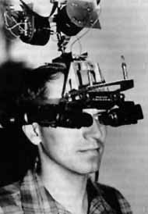
Ivan Sutherland’s
The Ultimate Display
“Don’t think of that thing as a screen, think of it as a window, a window through which one looks into a virtual world. The challenge to computer graphics is to make that virtual world look real, sound real, move and respond to interaction in real time, and even feel real.”

Slide 7
Our definition (from Brooks’ What’s Real About Virtual Reality)
Virtual Reality Experience – the user is effectively immersed in a responsive virtual world.
Implies -> user dynamic control of viewpoint
Control becomes an important element of VR systems.
  Differentiates VR from books and movies (or watching movies in HMD)
  Why is control more important?

Slide 8
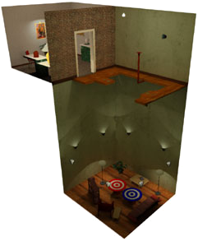
Key Elements of Virtual Reality Experience
Virtual World - content of a given medium
  screen play, script, etc.
  actors performing the play allows us to experience the virtual world
Immersion – sensation of being in an environment
  mental immersion – suspension of disbelief
  physical immersion – bodily entering the medium
  Related to presence – (mentally immersed) the participant’s sensation of being in the virtual environment (Slater)
Walking Experiment at
UNC – Chapel Hill

Slide 9
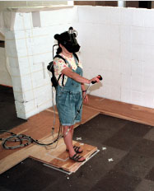
Key Elements of Virtual Reality Experience
Sensory Feedback – information about the virtual world is presented to the participant’s senses
  Visual (most common)
  Audio
  Touch
Interactivity – the virtual world responds to the user’s actions.
  Computer makes this possible
  Real-time
Walking Experiment at
UNC – Chapel Hill

Slide 10
Other Definitions (from book)
Artificial Reality – synthetic environments in which a user may interactively participate
Virtual – not real. representations of physical objects.
Virtual World, Virtual Reality, Virtual Environments – used interchangeably.
  Brooks – we aren’t even close to creating realities yet.
Cyberspace – location that exists only in the mind of the participants.

Slide 11
Virtual Environments
Augmented Reality (Mixed Reality)
Telepresence
Artificial Reality
Classical Simulation Environments
Virtual Reality
All Virtual Objects
All Real Objects

Slide 12
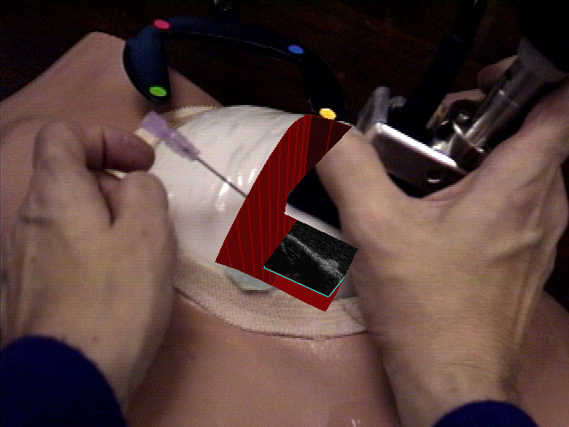
Augmented Reality
A combination of a real scene viewed by a user and a virtual scene generated by a computer that augments the scene with additional information.
Ultrasound Visualization Research at
UNC – Chapel Hill
Notes:
Generates a composite view for the user.

Slide 13
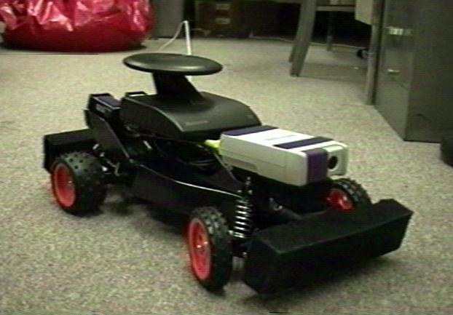
Telepresence
  The use of various technologies to produce the effect of placing the user in another location.
Notes:
Generates a composite view for the user.

Slide 14

Artificial Reality (Myron Kruger)
Responsive Environment
Is an environment where human behavior is perceived by a computer which interprets what it observes and responds through intelligent visual and auditory displays

Slide 15
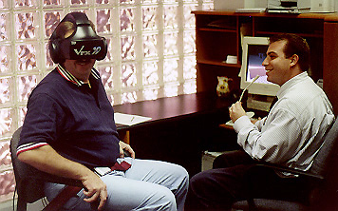
Classical Simulation
Classical simulation is a mix of real objects and computer generated stimuli.

Slide 16
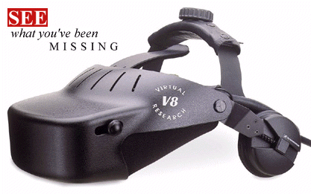
Immersive Technology
Head-mounted Display
  Optical System
  Image Source (CRT or LCD)
  Mounting Apparatus
  Earphones
  Position Tracker

Slide 17
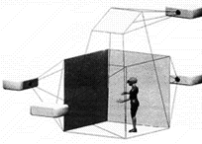
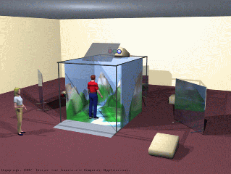

Immersive Technology
Multi-screen Projection of stereoscopic images (CAVE)

Slide 18
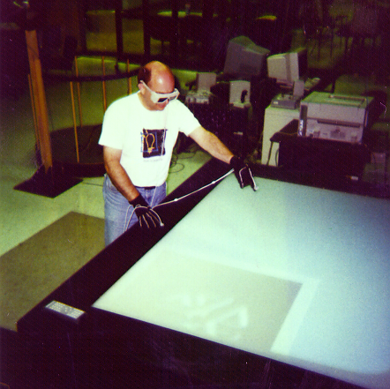
Immersive Technology
Single large stereoscopic display
  Projection-based
  Head-tracked
  Possible tracking of hands and arms.
  Brings virtual objects into the physical world

Slide 19
Other Characteristics
Head and body tracking implies that visual content is always computed and rendered in “real time” (10-60 frames/second).
In virtual reality you have a sense of, and interact with, three-dimensional things as opposed to pictures or movies of things.

Slide 20
What are the primary intellectual components that create a virtual environment?
Hardware / Technology
User’s Perspective (the environment that is experienced)
System Software Design
Interaction Techniques

Slide 21
Hardware / Technology
What display modalities and technologies will I use?
What sensor modalities and technologies will I use?
What is my computation environment?
How many active users do I wish to accommodate?

Slide 22
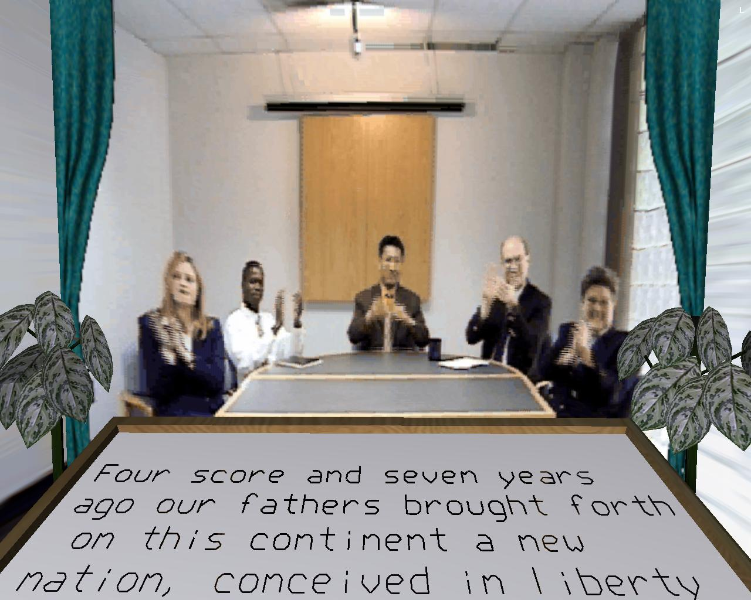
User’s perspective
Setting
Objects in world
Other participants
Active/Passive
  Factory Simulation
  Architectural Walkthrough

Slide 23
System Software Design
Software structures that run the virtual environment
  Rendering group
    Graphics, audio, haptic
  Sensor polling group
    Separately poll each sensor hardware subsystem
  Computation group
    Manage the state of the environment

Slide 24
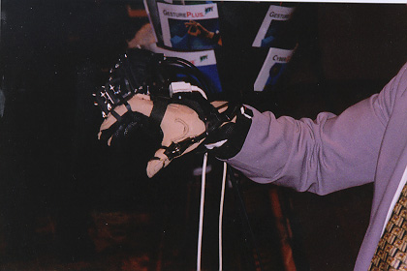
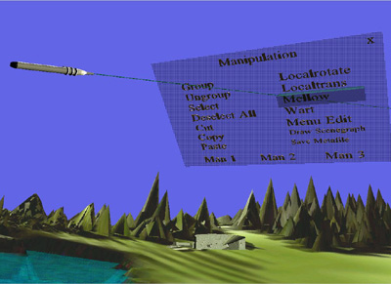
Interaction Techniques
Do I interact with the environment?
How do I interact with the environment?
Not the same as what devices I use

Slide 25
Applications?
Most current applications:
Special Purpose
Interaction simple and/or infrequent
Limitations of graphics and haptics
A few expensive systems are sold to a few rich people

Slide 26
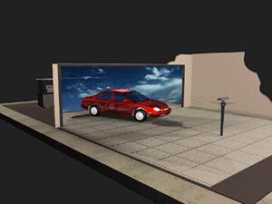
Design Visualization

Slide 27
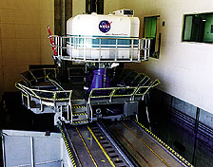
Training (NASA)

Slide 28
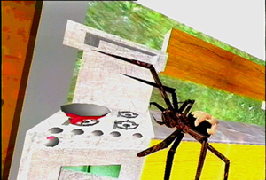
Clinical Virtual Reality
Hunter Hoffman
HITLab – University of Washington
The direct use of VR as a tool in the treatment or assessment of psychological and physical disorders.

